Slide 1
Collecting Geologic Samples: An Example with Meteorites
Contributors: Christine Y. Chen
Keywords: meteorites, planetary science, resource extraction, museums, Indigenous groups, Inuit, Inughuit
Location: United States, Greenland, Arctic
People: Robert E. Peary, Minik Wallace
Last updated: December 6, 2020
Visit https://geo-context.github.io for the teacher’s companion guide to these slides.

Slide 2
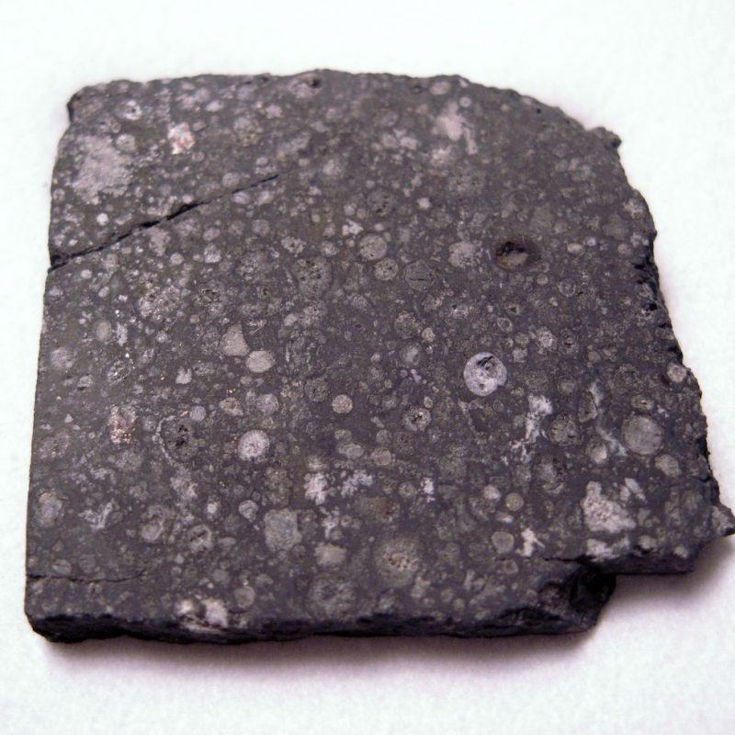
Meteorites
Fragments of asteroids, other planets, comets, and the Moon
Provide information about the origin and evolution of Earth, other planets, and the Solar System:
origin of Earth’s water;
differentiation of Earth’s crust;
possible role of meteorites in delivering extraterrestrial sugars (precursors for life) to Earth
formation of the solar nebula
Famous, well-studied meteorites: Allende, Gibeon, Murchison, Cape York
11.51 gram partial slice of Allende. ASU collection.
Wikimedia Commons.
Notes:
The Ahnighito Meteorite is the largest meteorite on display at any museum, weighing in at 34 tons.

Slide 3
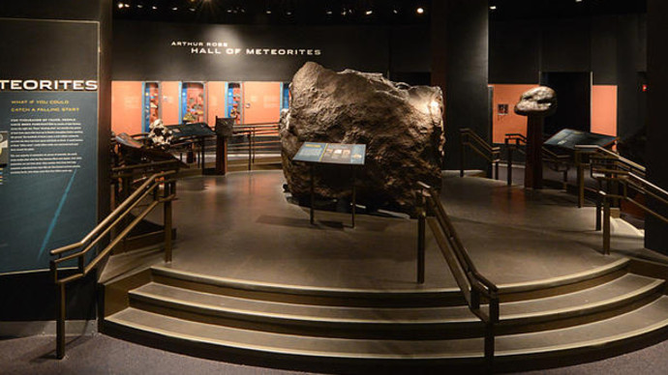
Ahnighito meteorite, fragment of the Cape York meteorite
Hall of Meteorites, American Museum of Natural History
The dark history behind the largest meteorite ever displayed, and a resource still used in science today.
Jonathan Blair, National Geographic
Notes:
The Ahnighito Meteorite is the largest meteorite on display at any museum, weighing in at 34 tons.

Slide 4
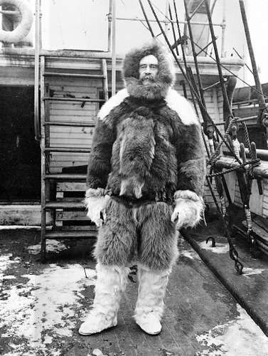


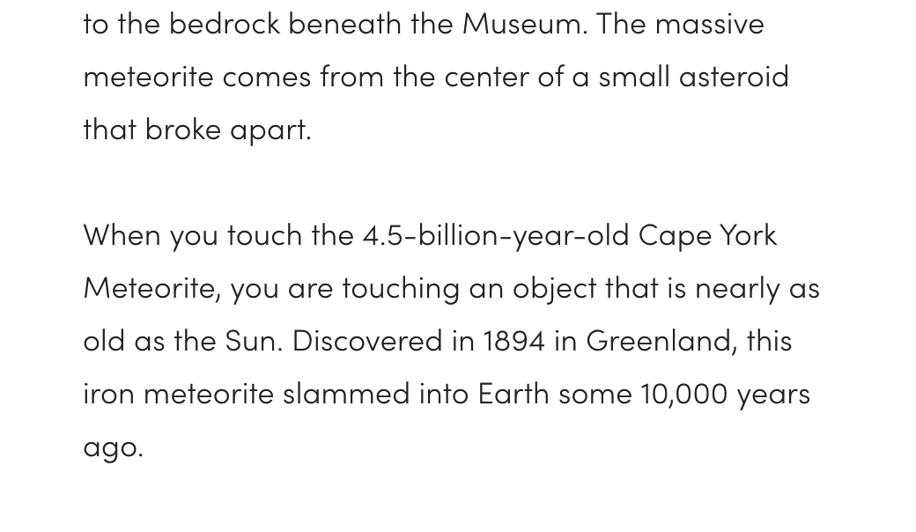
“Discovered” in Greenland by 1894 Robert E. Peary
Language on AMNH.org only recognizes Peary, a problematic framing that does not acknowledge the humanity of the Inughuit.
Ahnighito, American Museum of Natural History
Robert E. Peary on the SS Roosevelt, 1906, Library of Congress

Slide 5
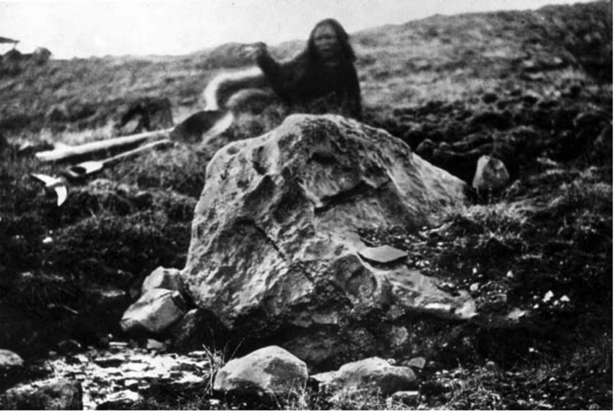
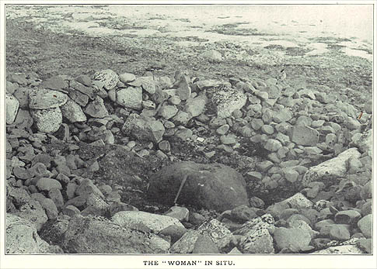
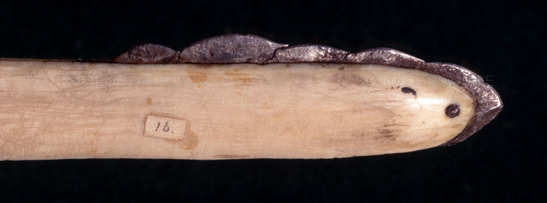
Cape York meteorites: Source of iron for the Inughuit
An iron meteorite ~4.5 billion years old, falling in NW Greenland ~10,000 yrs ago
An essential source of iron for the Inughuit, the Inuit living in Greenland
Heavy basalt stones used for hammering off metal flakes to make blades
Handtool by
Inughuit
“The Woman” in situ, surrounded by hammer stones carried >50 km to site
“The Tent” fragment (Ahnighito) in situ
Huntington (2002), AMNH
R.E. Peary (1898) Northward Over the “Great Ice”
The Natural History
Museum, London
Notes:
The Ahnighito Meteorite is the largest meteorite on display at any museum, weighing in at 34 tons.

Slide 6
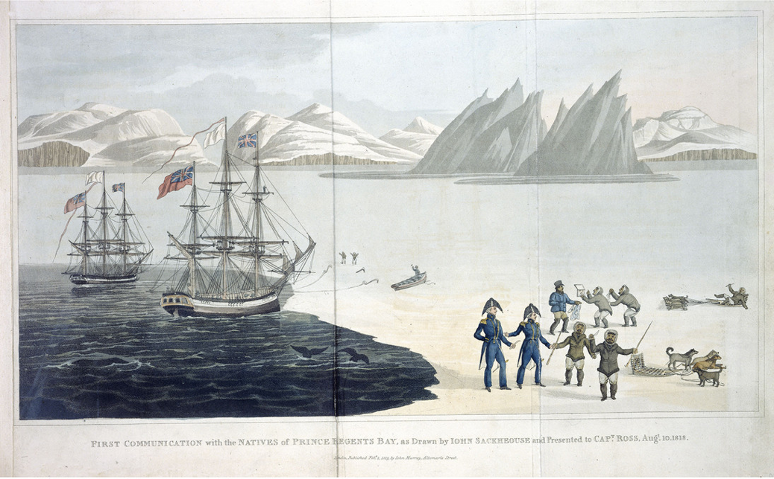
Timeline of Cape York meteorite removal from Greenland
1818: British naval officer John Ross, with Greenlander interpreter Sakæus, sail to NW Greenland and meet a group of Inughuit using iron-tipped tools/weapons.
Ross asks them where they obtained the iron, but they do not say, only referring to an “iron mountain,” wanting to protect their source from outsiders.
Ross brings back tools to England where the iron is confirmed to be meteoritic.
1886: American Robert E. Peary begins visiting the area regularly as a starting point for his quest to reach the North Pole.
Sakæus’s painting of meeting between
Captain Ross and Inughuit
John Ross (1819) A Voyage of Discovery.

Slide 7
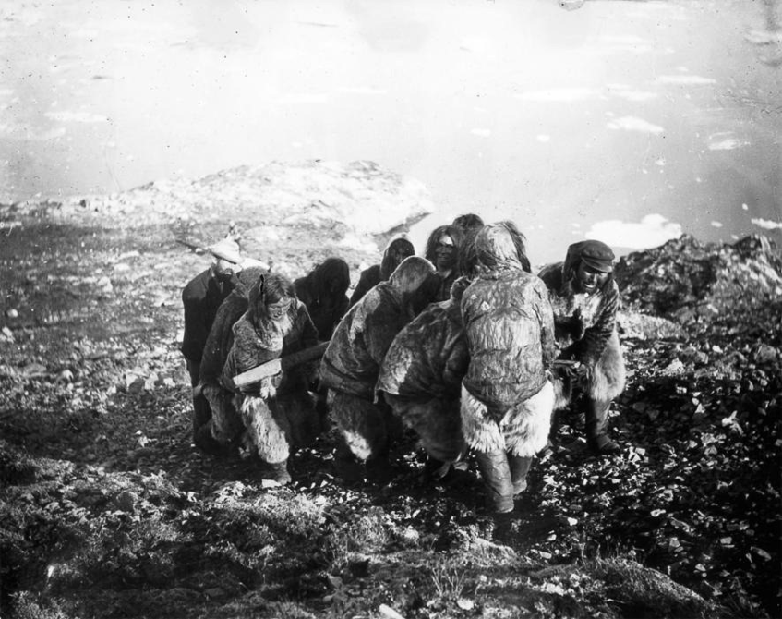
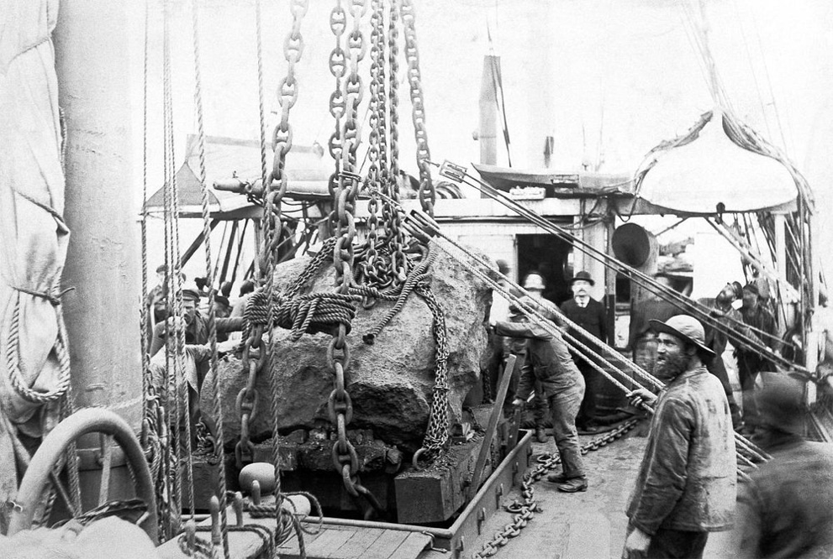
Timeline of Cape York meteorite removal from Greenland
1894: A member of the Inughuit shows Peary “the Tent,” “the Woman,” and “the Dog” in exchange for a gun. Perry renames “the Tent” after his daughter’s middle name, Ahnighito.
1895–1897: Without asking for permission, Perry takes all three meteorite blocks on his ships back to New York, paying local Inughuit in rifles, pots, pans, and knives to lift and move them.
Local Inughuit hauling a jack for meteorite
“The Tent” block secured on board The Hope
National Geographic
National Geographic

Slide 8
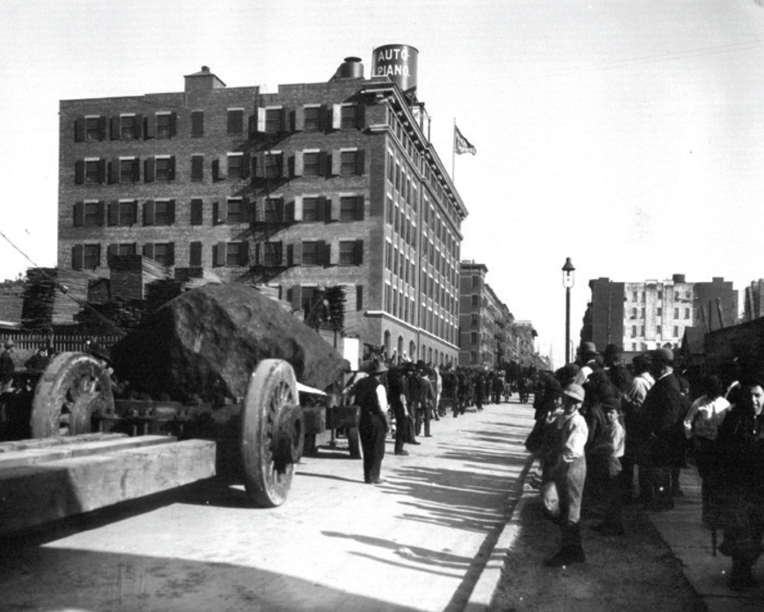
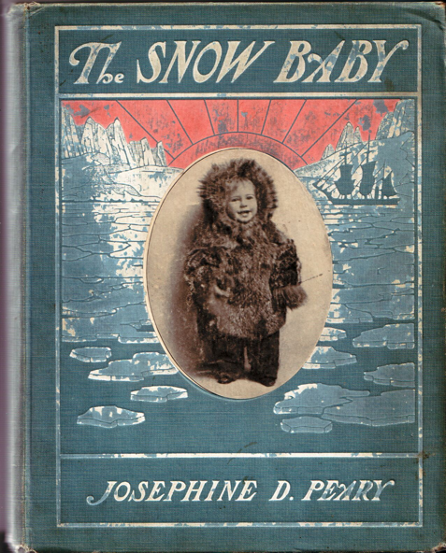
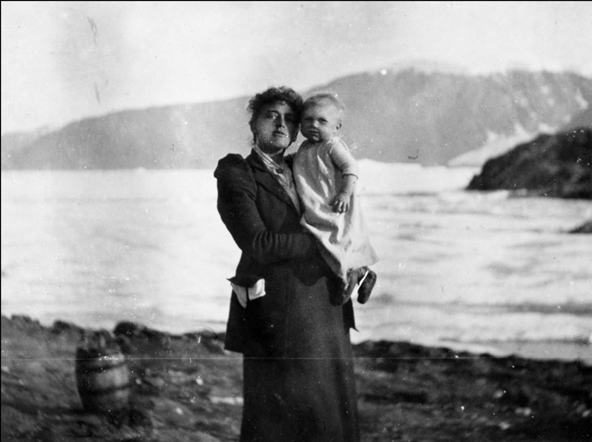
Timeline of Cape York meteorite removal from Greenland
1909: Josephine Peary, Peary’s wife who accompanied him on the 1897 Greenland trip, sells “the Tent” to AMNH for $40,000, or $1M in today’s dollars. She claimed Peary gave them to her, and that it was the only property she had to raise her children in the event her husband died.
28 horses hauling Ahnighito to AMNH
Josephine Peary’s The Snow Baby (1901)
Josephine Peary with daughter Marie Ahnighito Peary
American Museum of Natural History
National Geographic
Frederick A. Stokes Company

Slide 9
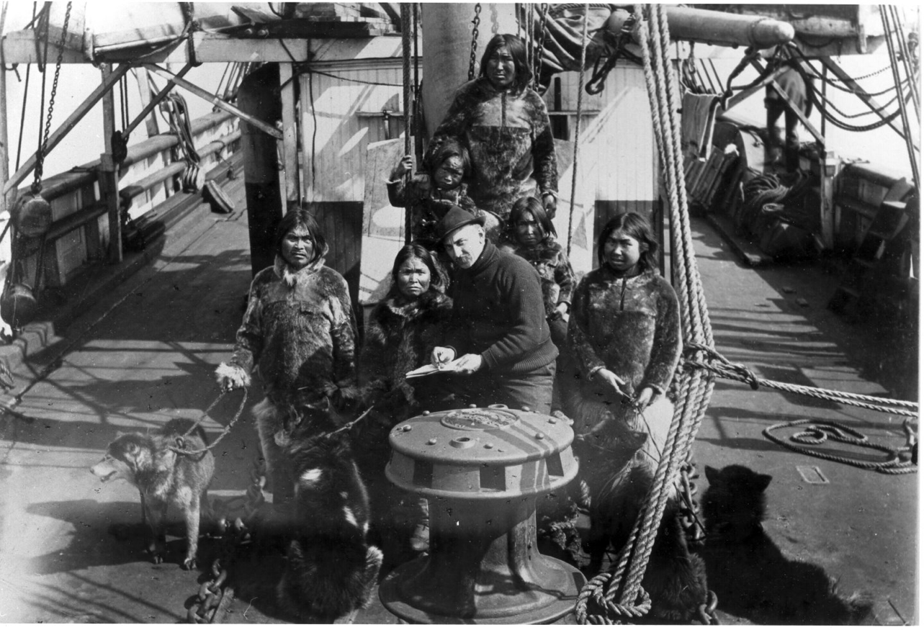
Peary also brought six Inughuit to New York
Six Inughuit aboard The Hope en-route to New York, 1897
Qisuk, Minik’s father, widowed
1897: Anthropologist Franz Boas (AMNH) asks Peary to invite an Inughuit man to stay in New York for a year to record his culture with museum staff.
Peary brings six people instead. The group includes a 7-year-old boy named Minik.
Minik
Aviaq
Nuktaq
Uisaakassak
Atangana
Albert Operti
Caught in the Middle: the Tragic Life of Minik Wallace

Slide 10
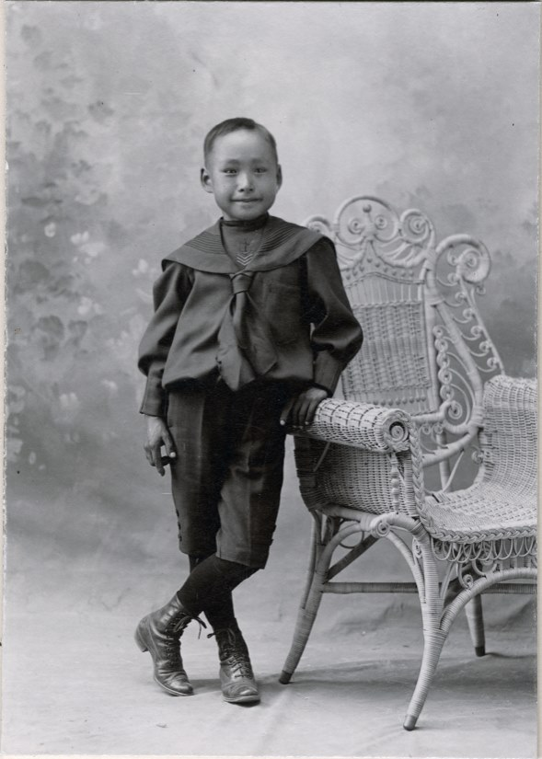
Minik (or Mene) Wallace
Minik in 1899
Age 8: Within months of arriving in New York, Nuktak, Atangana, Aviaq, and Minik’s father Qisuk all die of tuberculosis. Minik, now an orphan at age 8, is adopted by William Wallace, the AMNH superintendent.
Age 18: Minik finds out from newspaper reports that museum staff had faked his father’s funeral, burying a log wrapped in a shroud while his father’s body was dissected, his bones preserved in the museum’s collections. Minik tries for years to get his father’s bones back, but is unsuccessful.
Age 20: Minik returns to Greenland, but finds that in his many years away, he has forgotten much of the language and other basic survival skills. In time, he relearns his native language and masters outdoor skills, and becomes a sought-after assistant in expeditions led by Americans.
Caught in the Middle: the Tragic Life of Minik Wallace

Slide 11
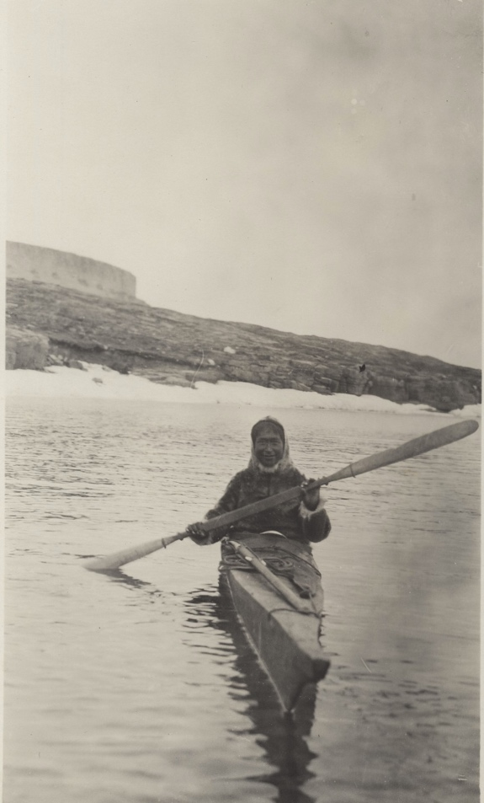
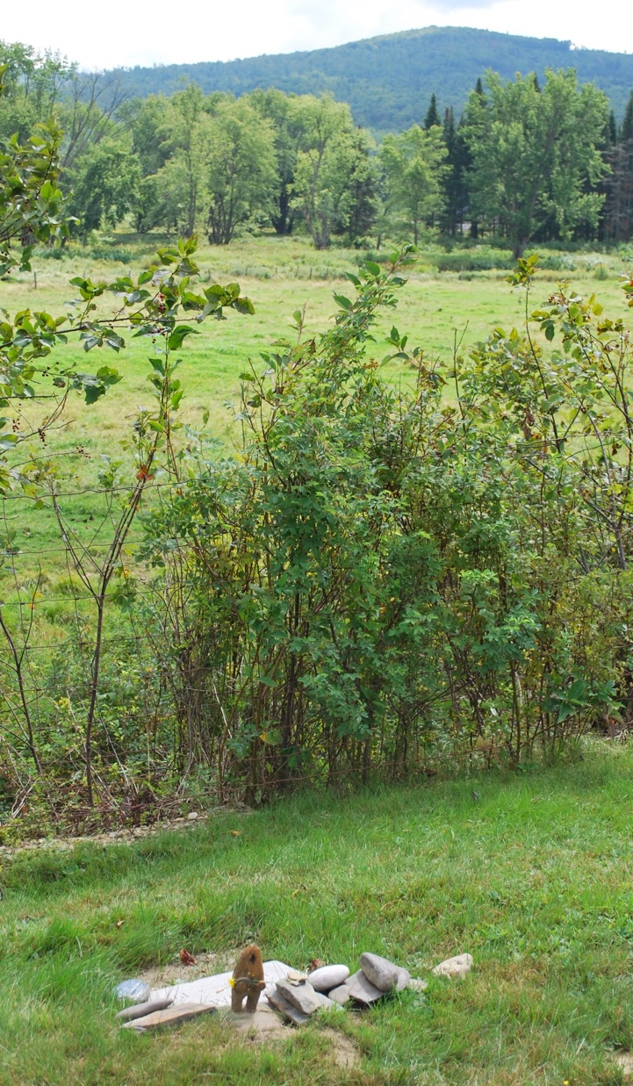
Minik Wallace
Age 28: Minik returns to the United States and takes a job at a lumber camp in New Hampshire.
Age 29: Minik dies of Spanish flu during the 1918 pandemic.
Above: W. Elmer Ekblaw, Mene in Kayak, Umanak, North Star Bay, Greenland, 1914. Gift of Margaret Tanquary Corwin.
Right: G. LeMoine, View of the grave of Minik Wallace. Indian Creek Cemetery, Pittsburg, New Hampshire, 2018. Arctic Museum Collection.

Slide 12
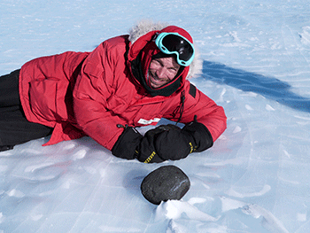
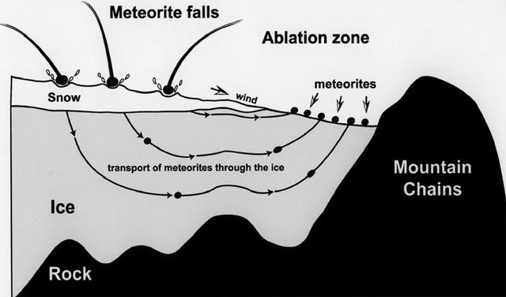
How meteorites are collected for science today
Best places to find meteorites are barren, dry, and old landscapes where dark rocks are easy to spot (e.g., Mojave Desert, Antarctica)
Science expeditions vs. acquisition by private collectors
ANSMET: Antarctic Search for Meteorites, funded by the National Science Foundation
ANSMET/Case Western University
Meteorite accumulation in Antarctica. Figure redrawn after drawing of L. Schultz, Max-Planck-Institute für Chemie (Mainz). ResearchGate
Notes:
The Ahnighito Meteorite is the largest meteorite on display at any museum, weighing in at 34 tons.

Slide 13
Discussion questions
What is the value of displaying things in museums? Should museums continue to exist in their current form? Are there tradeoffs in where and how samples are acquired? Who “owns” a sample when it is collected? Are there situations in which samples should not be collected?
How does fieldwork and sample collection in geosciences generally work today? How common are long-term, mutually-beneficial partnerships between researchers and communities local to field sites? How have modern practices inherited the legacies, traditions, and attitudes practiced by Robert Peary and other Western explorers from his era?
Fragments of the Cape York meteorite are still located in museums (AMNH, Copenhagen) and sold as classroom materials by vendors. Many pieces exist in the collections at various geology departments in the United States. Given their history, what should be done with these materials?

Slide 14
Further readings and sources
References:
Patricia A. M. Huntington (2002) Robert E. Peary and the Cape York Meteorites, Polar Geography, 26:1, 53-65, DOI: 10.1080/789609353
Minik and the Meteor, Allison C. Meier, Narratively: Hidden History, 2013.
Caught in the Middle: the Tragic Life of Minik Wallace, Perry-MacMillan Arctic Museum, Bowdoin College, 2020.
The Cape York meteorite: Making an impact on Greenland, Emily Johnson, University of Washington, 2019.
Martin Appelt et al. (2015) The Cultural History of the Innaanganeq/Cape York Meteorite. Technical Report. Greenland National Museum and Archives.
Additional sources:
Dr. Erin L. Thompson’s Twitter thread (@artcrimeprof) about the meteorite
“The Mad Scramble to Claim the World’s Most Coveted Meteorite.” Wired Magazine.

Slide 15
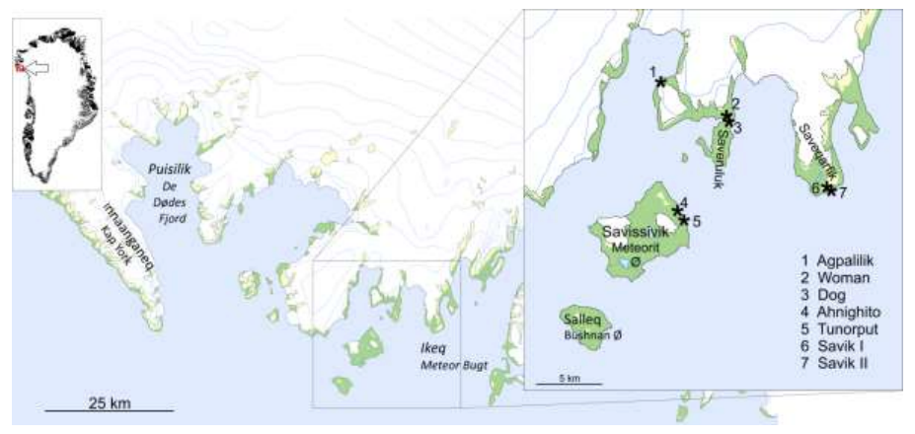
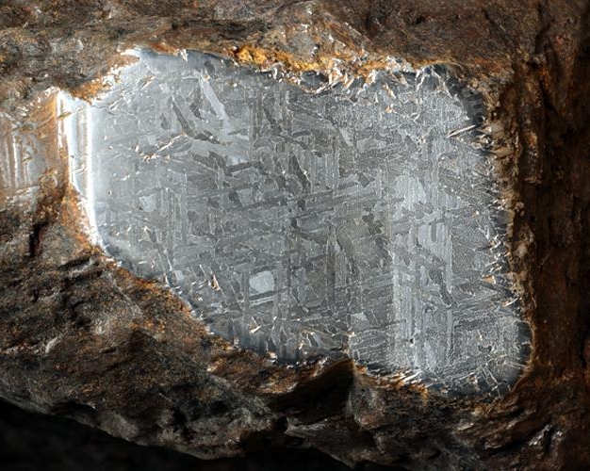
Supplemental figures, images, and information
Map of the locations of Cape York meteorite fragments
Widmanstätten pattern from Ahnighito meteorite
American Museum of Natural History/D. Finnin
Appelt et al. (2015)
The Cultural History of the Innaanganeq / Cape York Meteorite — Technical Report.
Notes:
The Ahnighito Meteorite is the largest meteorite on display at any museum, weighing in at 34 tons.

Slide 16
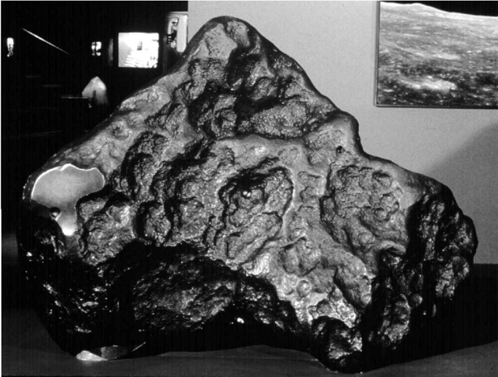
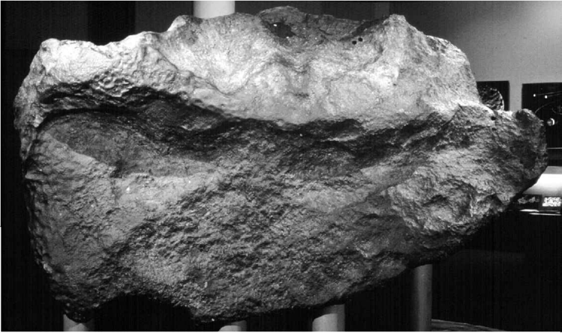
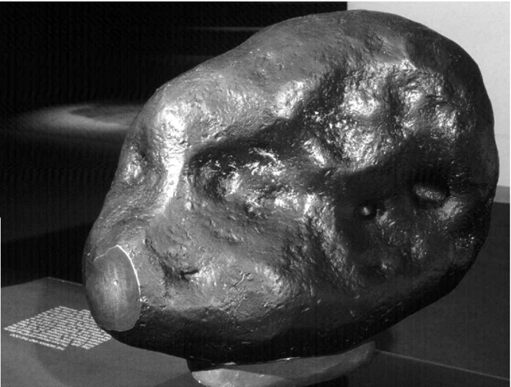
Supplemental figures, images, and information
“the Woman”
“the Tent”
“the Dog”
Notes:
The Ahnighito Meteorite is the largest meteorite on display at any museum, weighing in at 34 tons.

Slide 17
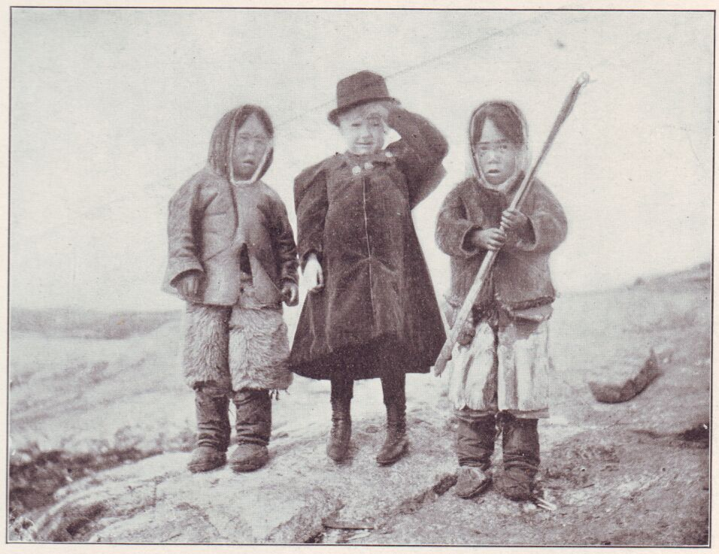
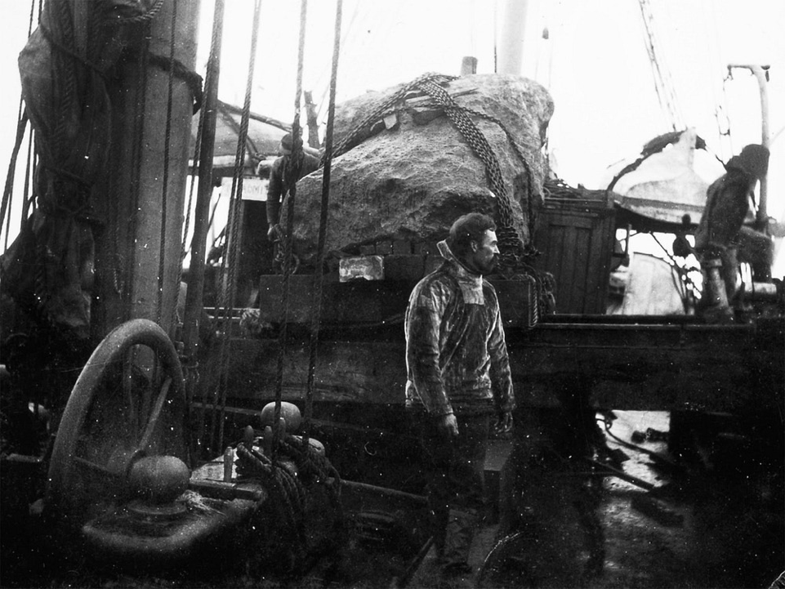
Supplemental figures, images, and information
Peary standing next to “the Tent” on the Hope
Peary standing next to “the Tent” on the Hope
National Geographic
Josephine Peary, The Snow Baby (1901)
Notes:
The Ahnighito Meteorite is the largest meteorite on display at any museum, weighing in at 34 tons.

